Slide 1
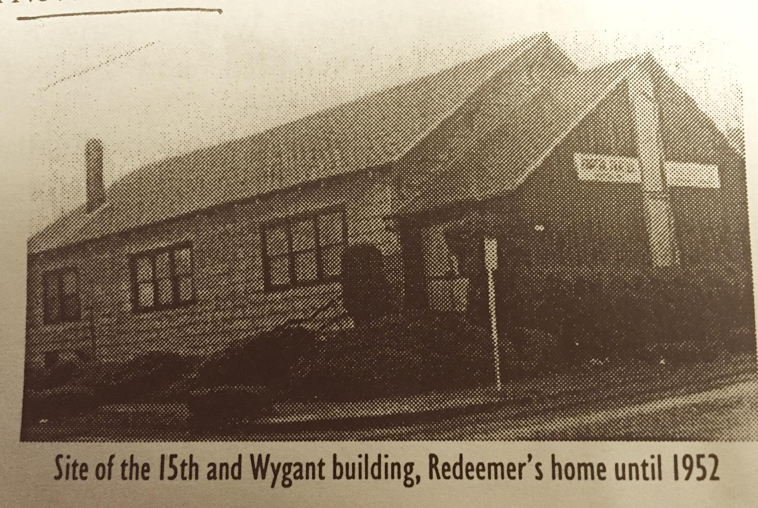
1920’s - 1940’s
Land and Buildings
15th & Wygant
March 17, 1920: The Evangelical Lutheran Church of the Redeemer incorporated
Property purchased for $2,800 by a member on condition congregation support him on the project.
June 7, 1942: Mortgage-burning ceremony

Slide 2
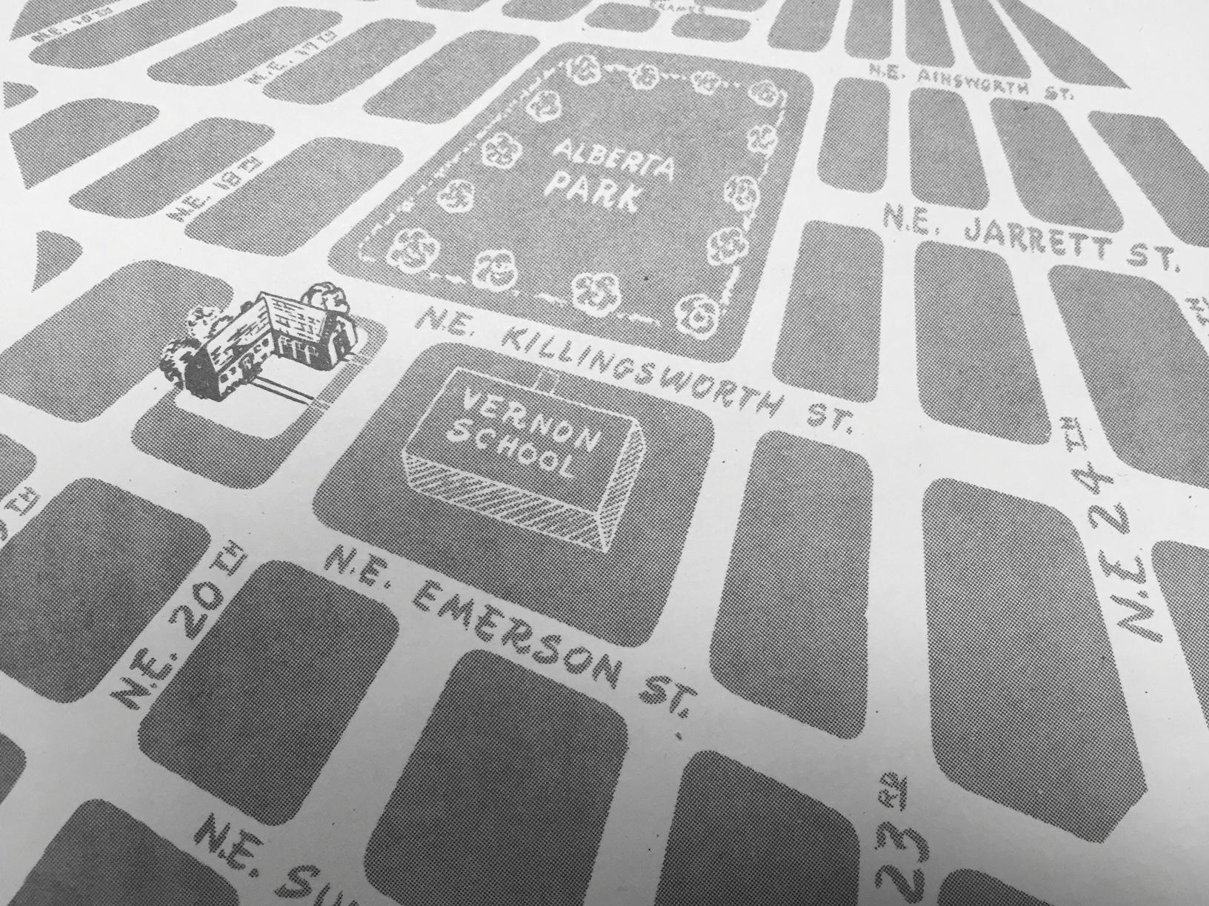
1940’s - 1950’s
Land and Buildings
20th & Killingsworth
November 1943: Property on 20th and Killingsworth purchased for $1000
February 24, 1952: Cornerstone laid
June 1, 1952: Building dedicated

Slide 3
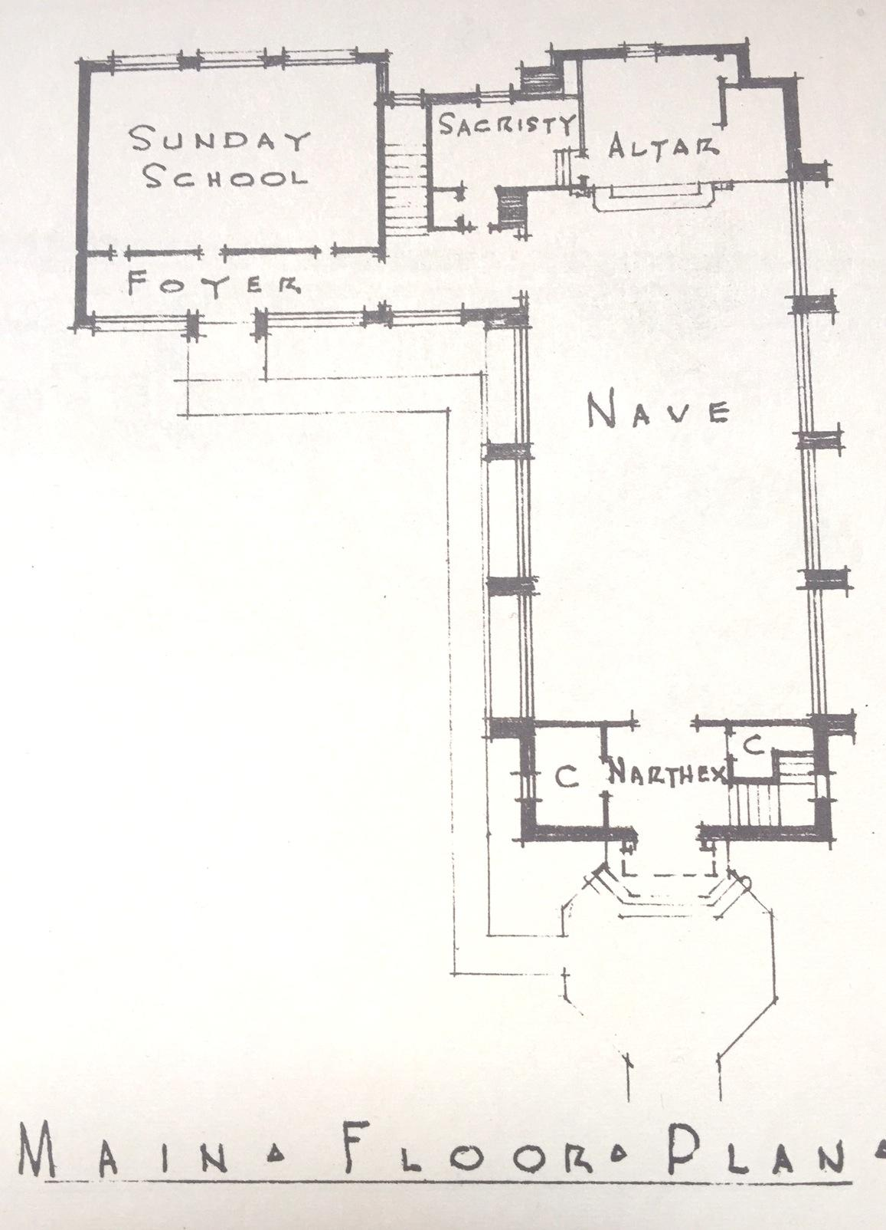
1952

Slide 4
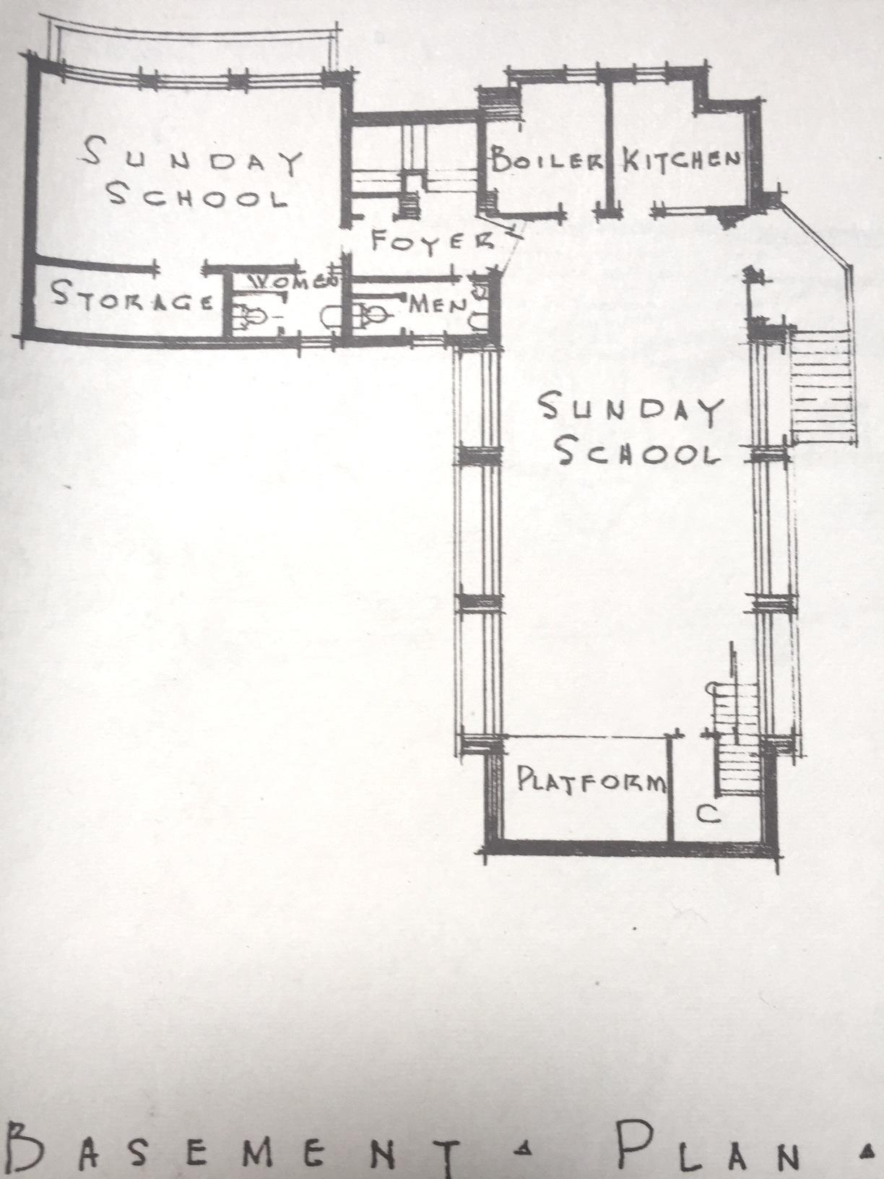
1952

Slide 5
Houses
1957: House purchased to house Sunday School
1960: Five houses and two extra lots were purchased and the houses razed for ample parking.
1950’s - 1960’s
Land and Buildings

Slide 6
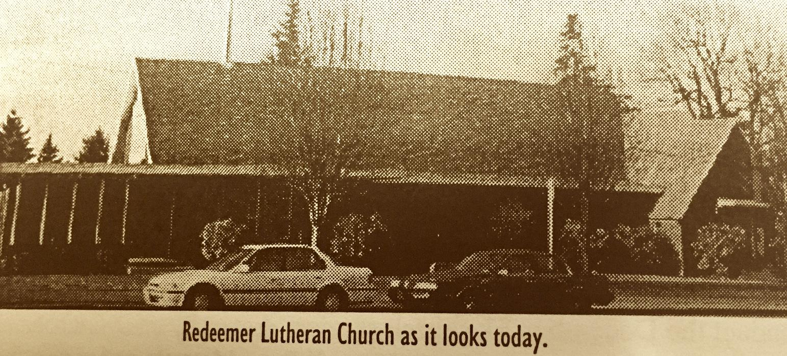
1960’s
Addition
April 25, 1965: Ground-breaking November 14, 1965: Dedication
Original building valued at $70,000 in 1952
additional land, $30,000
New addition, $155,000
Only $110,000 was borrowed from Lutheran Mutual Insurance Company. Rest raised by congregation.

Slide 7
Community
Women of Redeemer had many ways of earning money to help with various projects for the church, charities and other needs. They started in 1920 and continued into mid 2000’s.
1967 Mrs. W.I. Eck gave congregation 200 shares of AT&T stock to start scholarship fund for the education of youth and adults.
1960’s

Slide 8
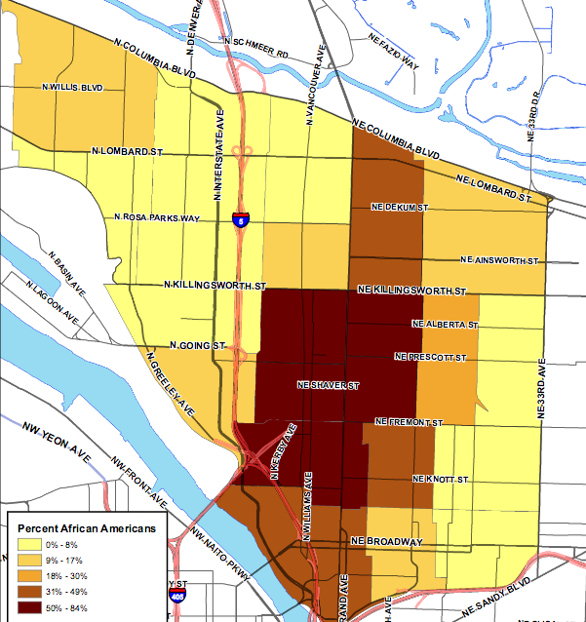
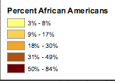
1970
*

Slide 9
Land and Housing in Ownership of Redeemer Lutheran
1970: Property on corner of NE 19th and Killingsworth, known informally as “The Ice Cream Store,” was purchased for $1,200. House was in disrepair and torn down. Area fenced and turned into a playground and/or vegetable garden.
1979 church purchased house on Killingsworth street adjacent to church property with a $12,000 gift from a member. It was rented to a family from congregation.
Addition
June, 1979: $110,0000 mortgage burning celebration.
1970’s
Land & Buildings

Slide 10
Community: 1970’s
Redeemer sponsored and help families resettling in America.
1977 one person from Vietnam...Van Tron. He worked and purchased several service stations in the area. Later he became a LCMS pastor and started ministries in Vietnam.
June 4 1979, with sponsorship of 10 churches and groups, Redeemer becomes the location of Alberta Park Loaves and Fishes
Women of Redeemer continue to raise funds and do projects for church and community programs.
1970’s

Slide 11
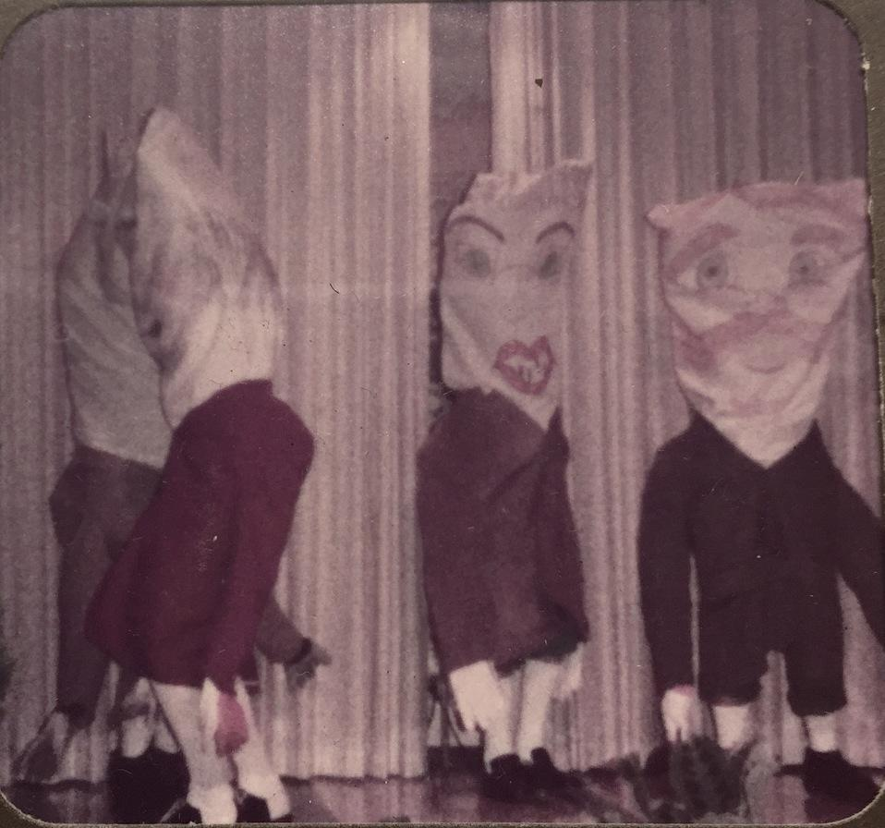
WOMEN OF REDEEMER SKIT 1970

Slide 12
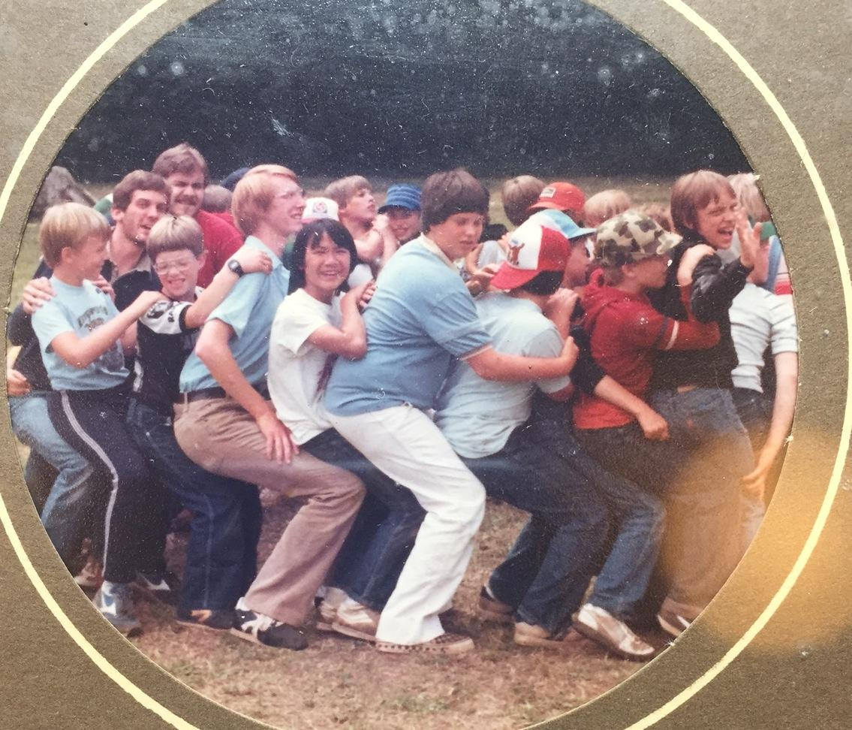
CAMP LUTHERWOOD: 1980’S
SISAVATH WAS REDEEMER MEMBER. FROM LAOS.

Slide 13
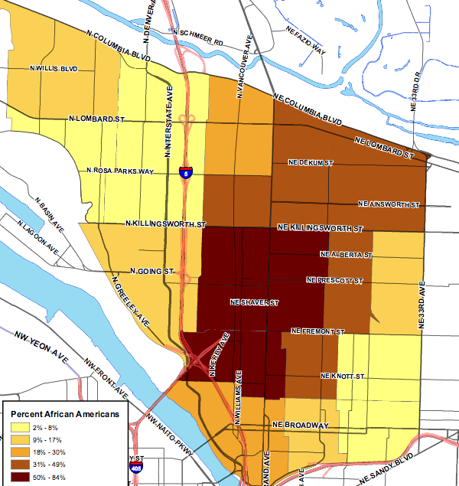
1980
*

Slide 14
1970
1980

Slide 15
Houses
1982 former pastor Werner Jessen and wife Ruth deeded additional property south of church thus expanding parking area and providing two garage bays for storage of equipment.
Land
1986 a member family donated parcel of land in Clark County, WA. Property sold. Part of a stewardship campaign. Undesignated funds to support the general mission of the congregation.
1980’s
Land and Buildings

Slide 16
Community: 1980’s
Jan 13, 1981 Rev. Terry Moe was called to pastor Redeemer Lutheran Church
Redeemer sponsored and help families resettling in America during the 1980’s.
Two families from Ethiopia,
Two families from Eritrea
Two families from Laos
One Polish family
Tigrinya language school classes held in building on Saturday mornings. Tigrinya ia the majority language spoken in Eritrea. The Eritrean community still had meetings in this building from that relationship until mid 2000’s.
Women of Redeemer continue to raise funds and do projects for church and community programs.
Redeemer is the location of Alberta Park Loaves and Fishes
1980: Vacation Bible School begins for neighborhood kids.
Late 80’s: Congregation is involved in community organizing with Portland Organizing Project.
1980’s

Slide 17
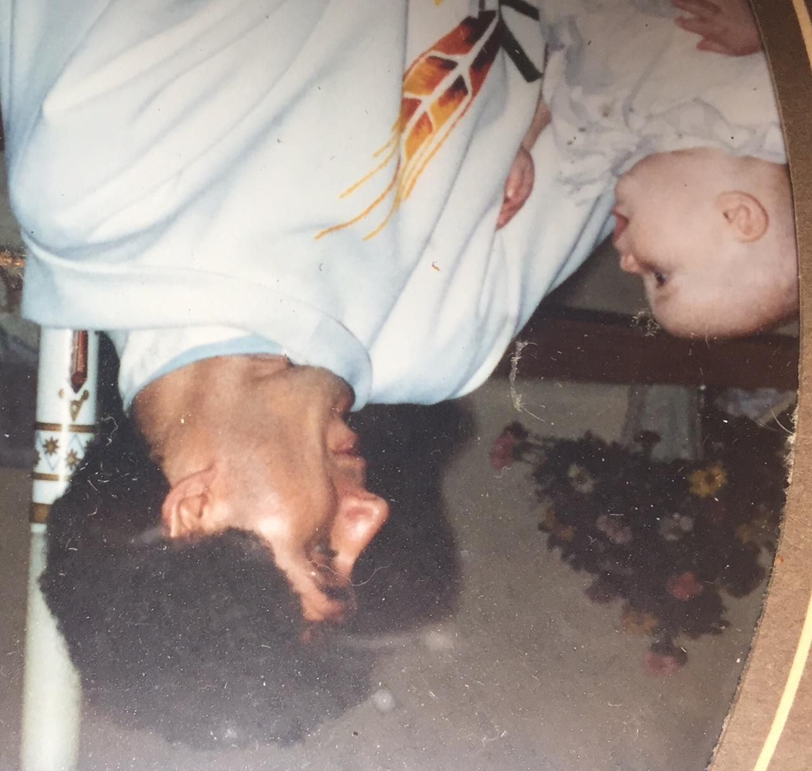
Pastor Terry Moe
19 Baptism in the late 80’s

Slide 18
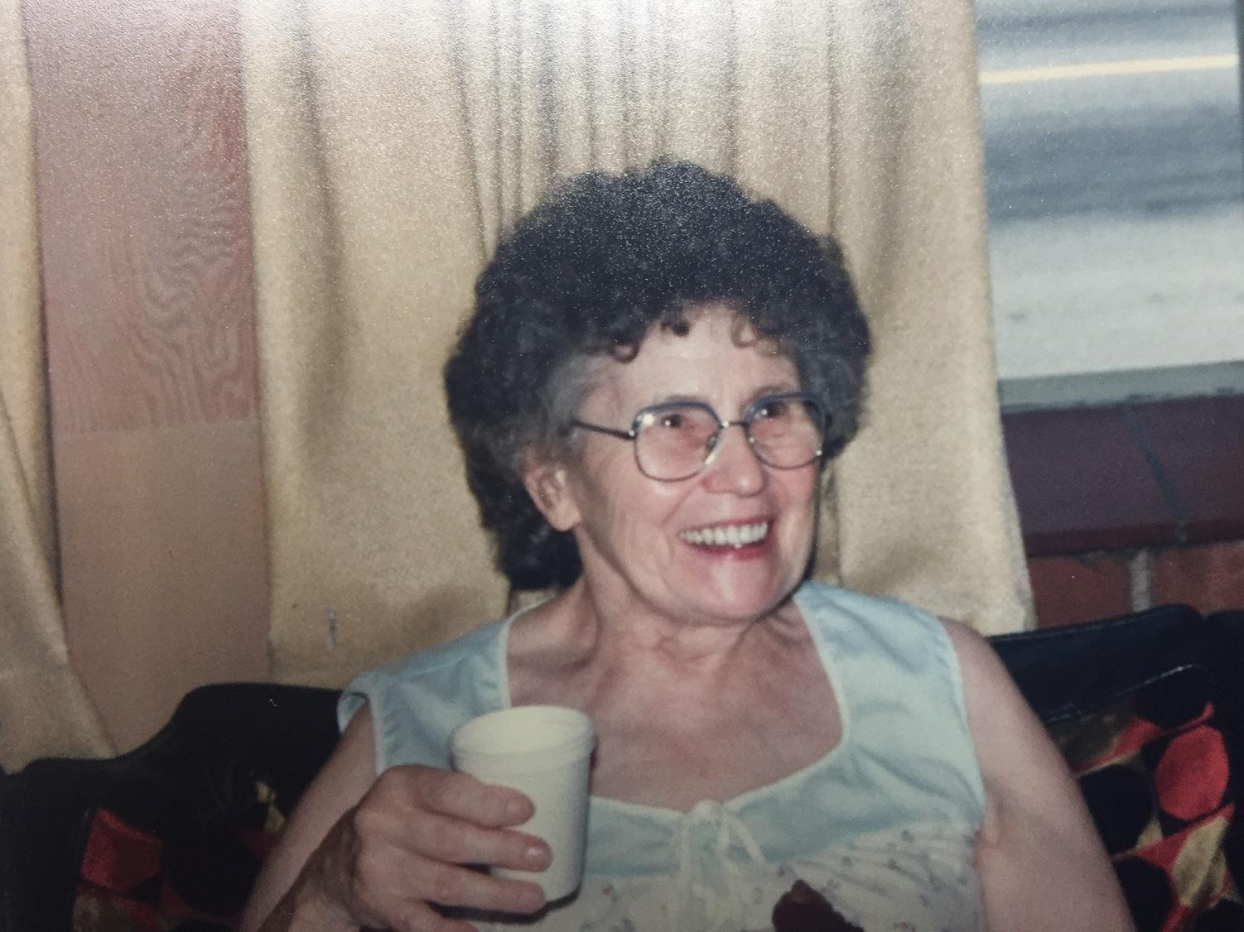
Madeline Jewett

Slide 19
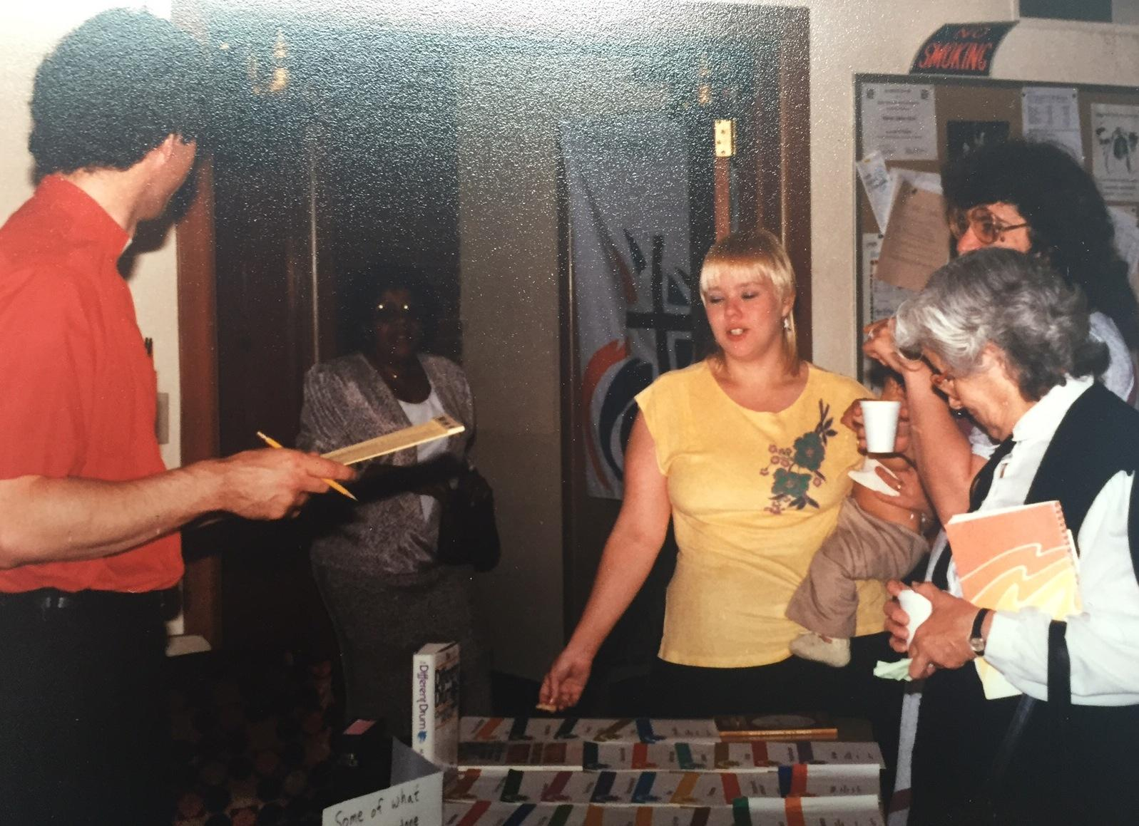
Pastor Moe, Laura Barber, Trish, Unknown, Joan Miller. Joan and Leo Miller were “solid rocks” in the congregation. Joan and Leo eventually moved to Eugene to be with family.

Slide 20
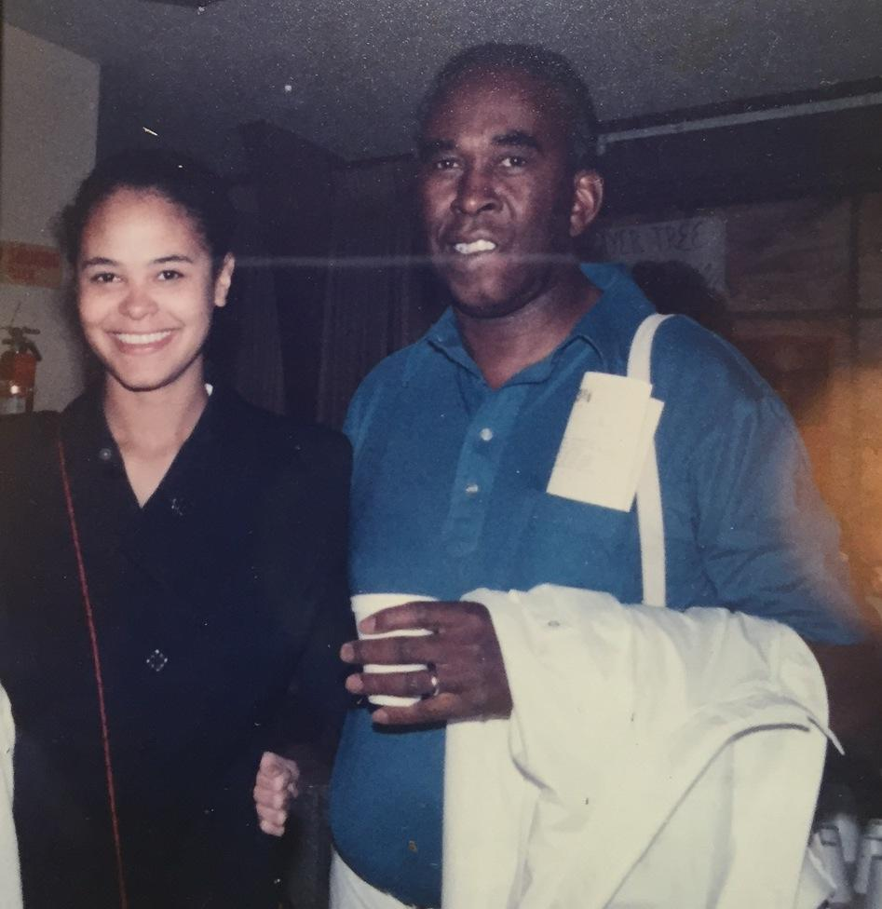
Ben webb and daughter,
Damaris Webb

Slide 21
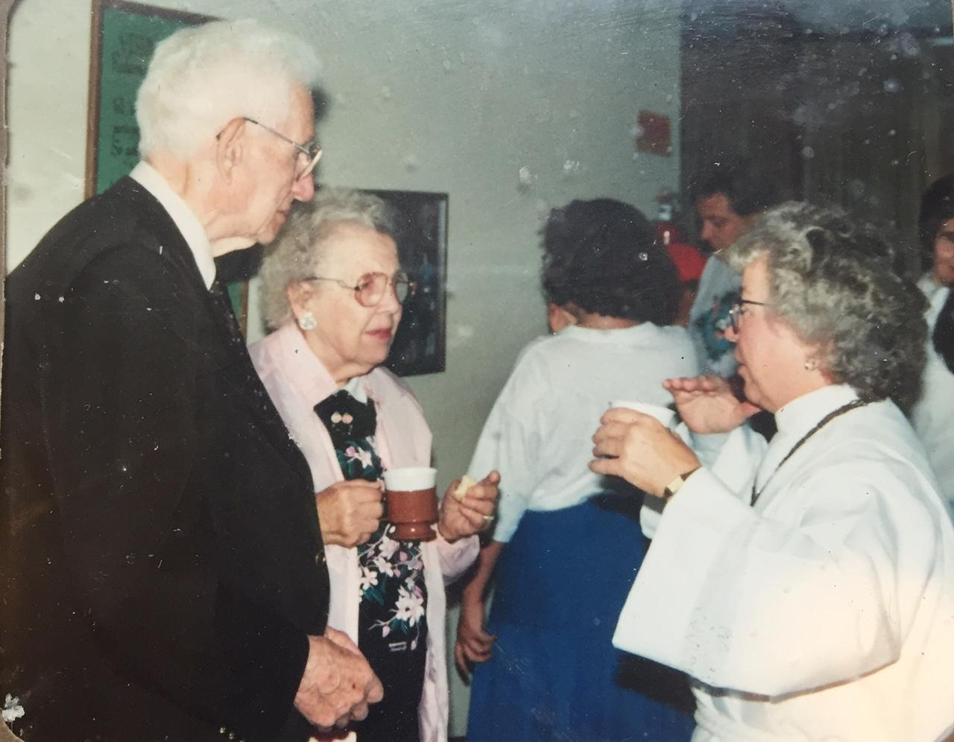
1991-92 Maurice and Mildred Hanson talking with third intern, Kay Doyle.

Slide 22
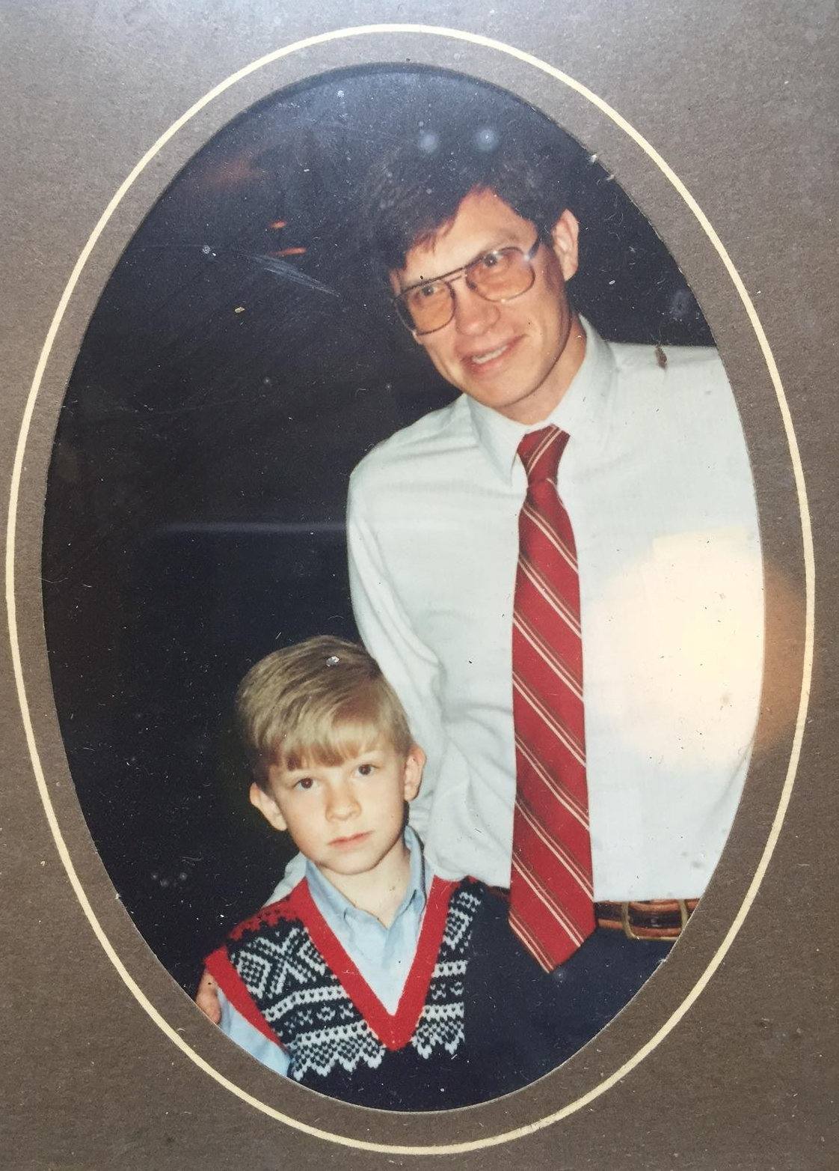
Jim Francis and son
Jim Francis and son, Kevin

Slide 23
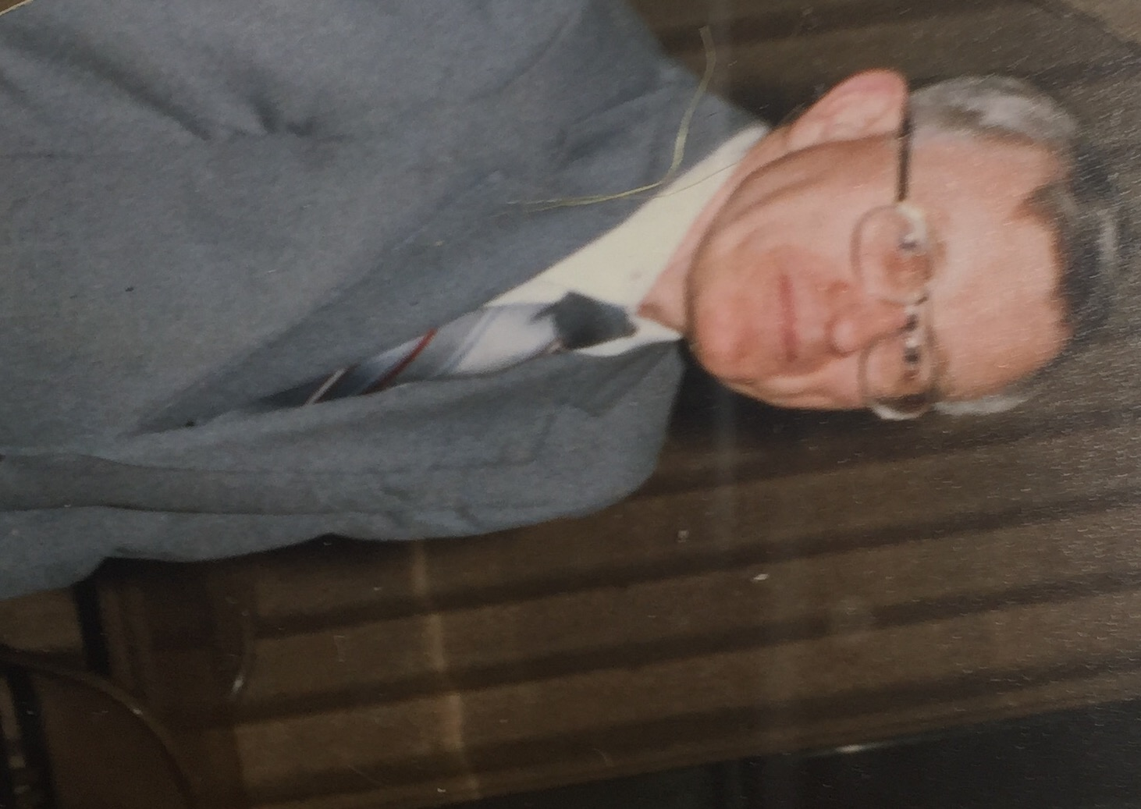
Eric Jordahl

Slide 24
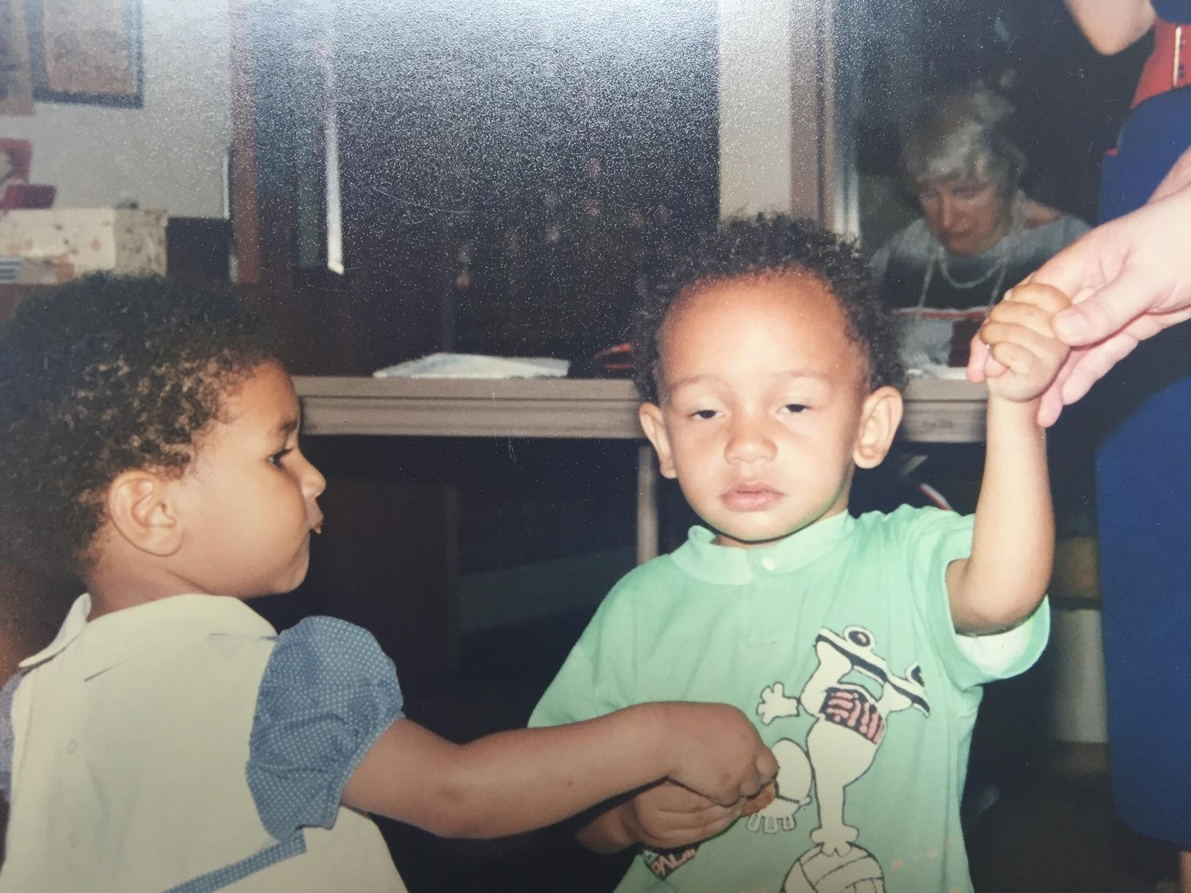
Ivy Flint and unnamed friend

Slide 25
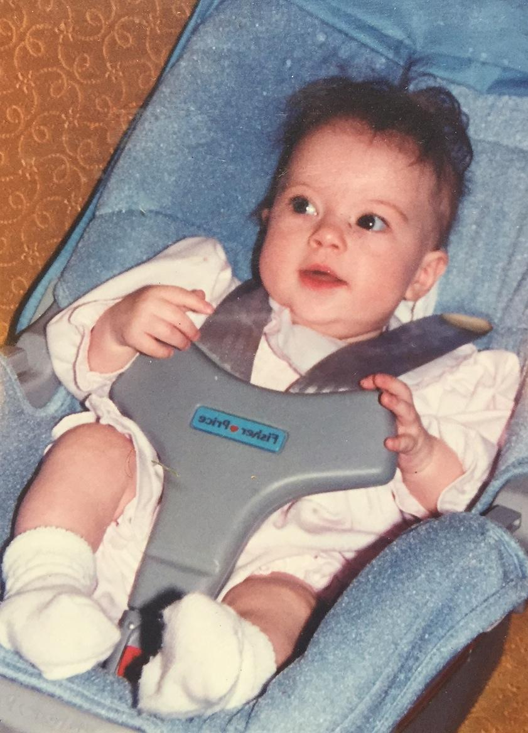
Sam Phelps?

Slide 26
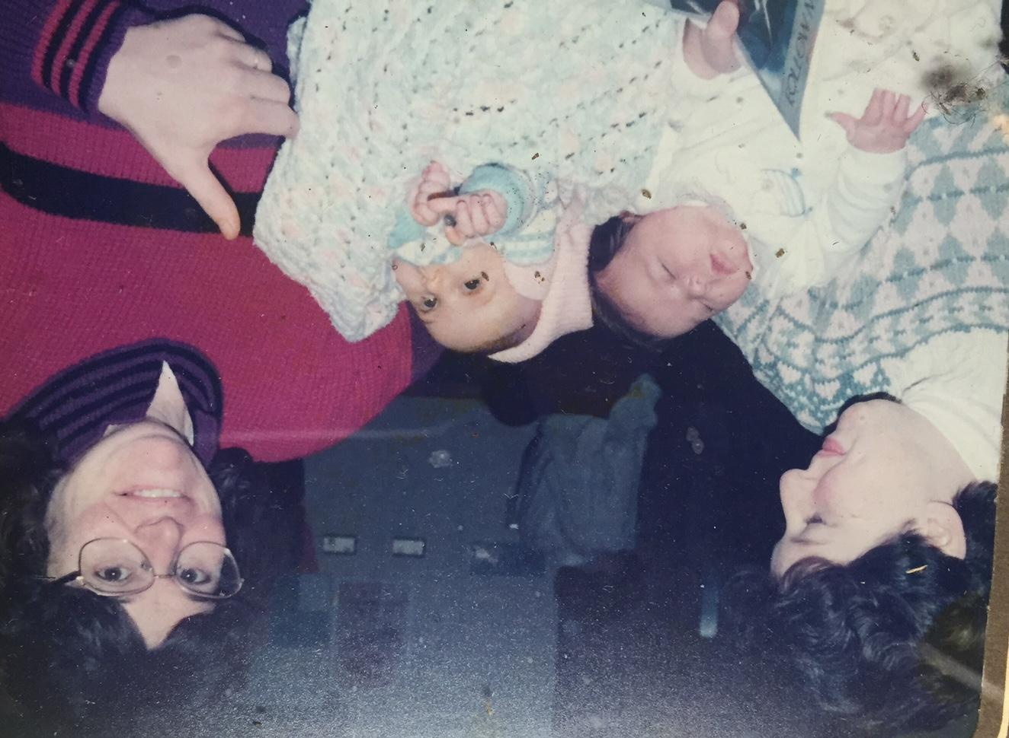
Dory Schutte &
Peggy Pietka with baby Jackie and Dory S Rochat-Schutte with baby Marie?

Slide 27
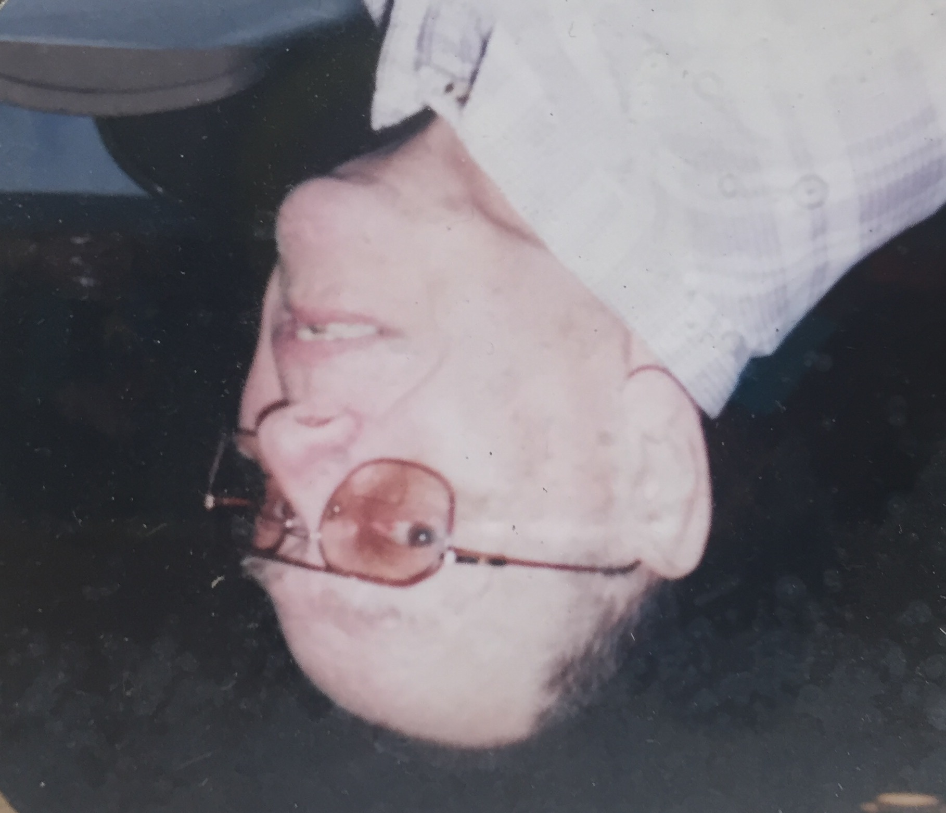
Bob Barner
Long Term member of Redeemer Lutheran.

Slide 28
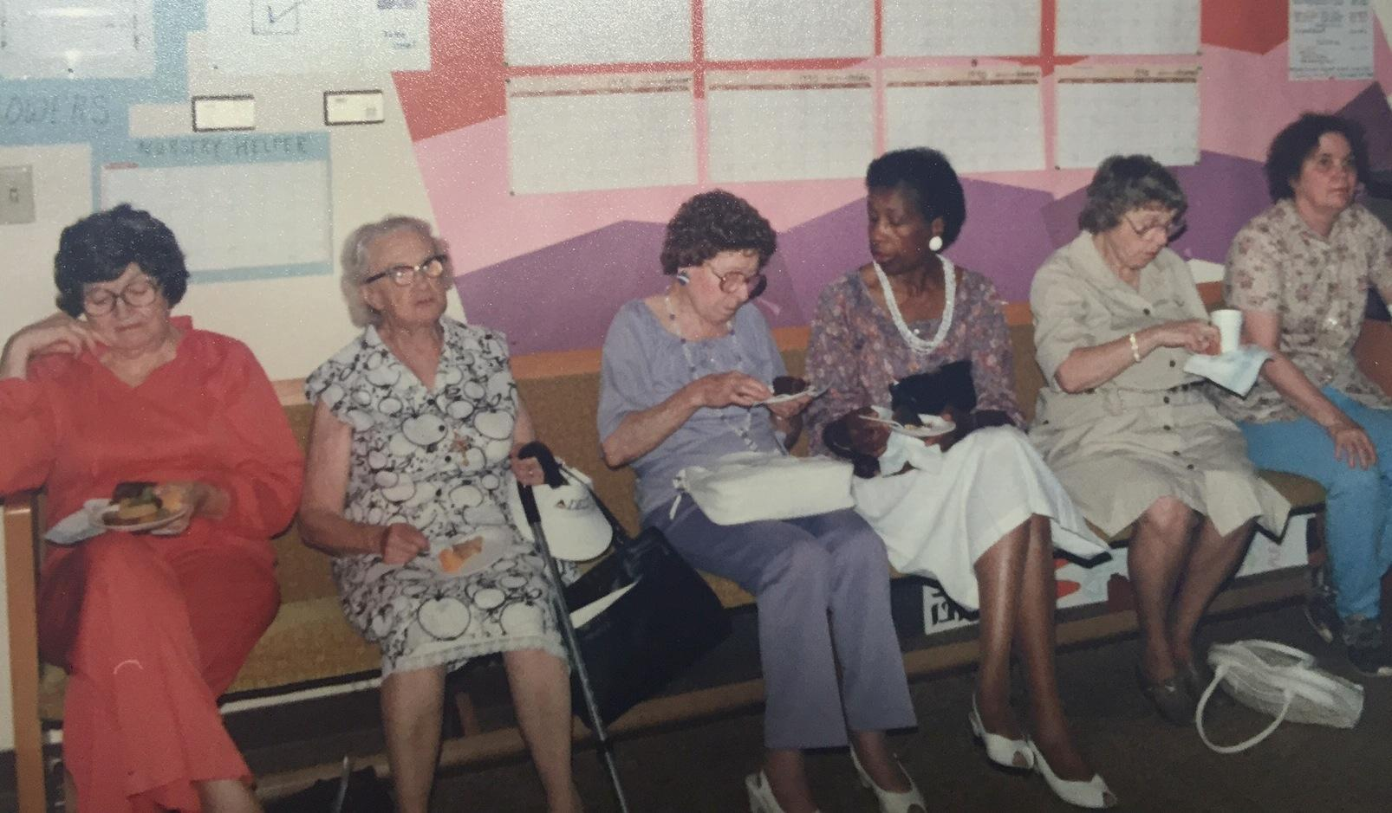
Vivian Richardson
(4th from left)
unnamed, Lydia Sloan, unnamed, Vivian Richardson, unnamed, Priscilla Morgan

Slide 29
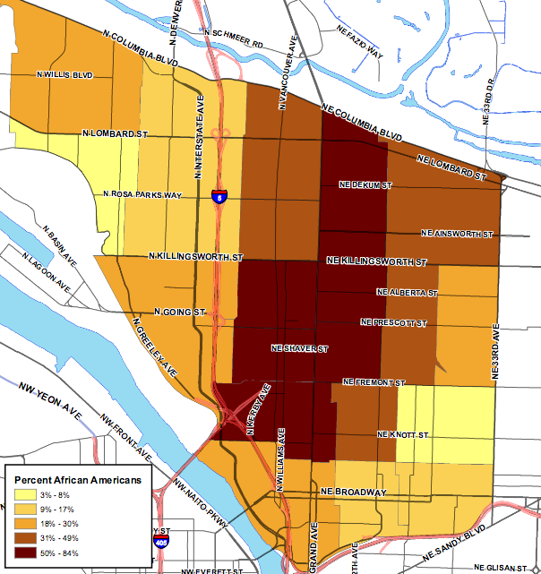
*
1990

Slide 30
1970
1990
1980

Slide 31
Community: 1990’s
Women of Redeemer continue to raise funds and do projects for church and community programs.
Redeemer is the location of Alberta Park Loaves and Fishes, until it is relocated to a new senior center on MLK Blvd in 1992.
Vacation Bible School is a collaborative effort with other churches in the area for neighborhood kids.
1990: 139 children attended, 18 staff members.
1990: Community children’s choir started called “Hallelujah Kids” choir.
Congregation is involved in community organizing with Portland Organizing Project.
Redeemer Lutheran accepted for the Horizon Internship Program which included funding for urban, rural and multiethnic communities. 19 interns from 1990 - 2008.
1952

Slide 32
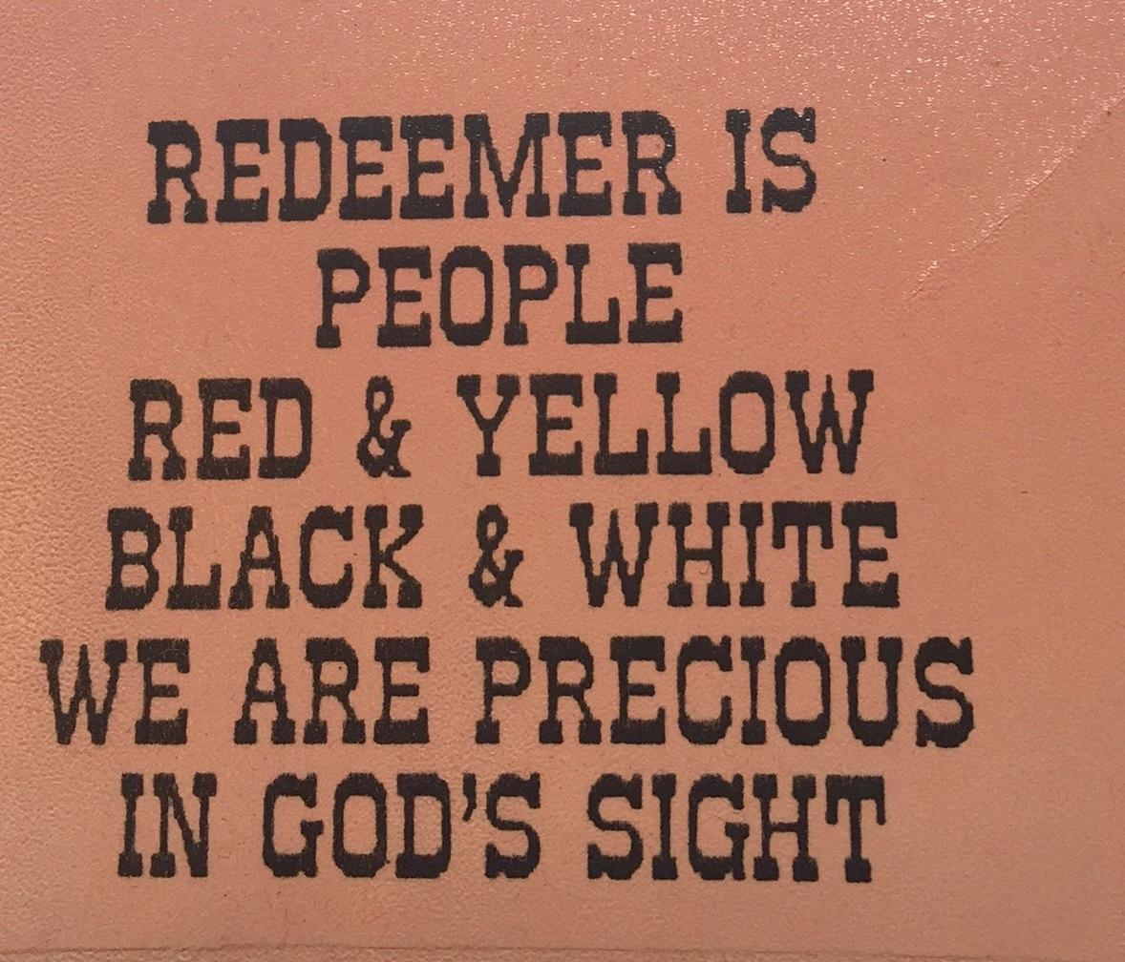

Slide 33
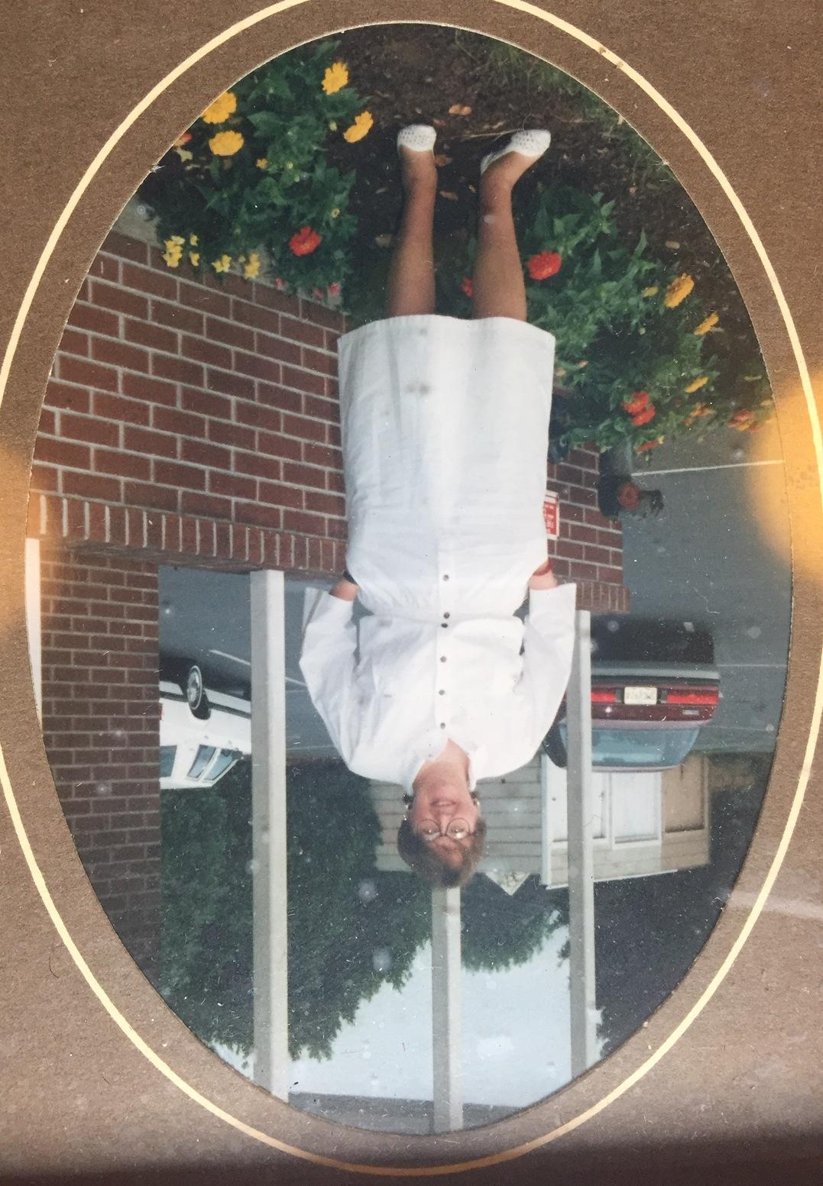
Jaquline Moren, second intern

Slide 34
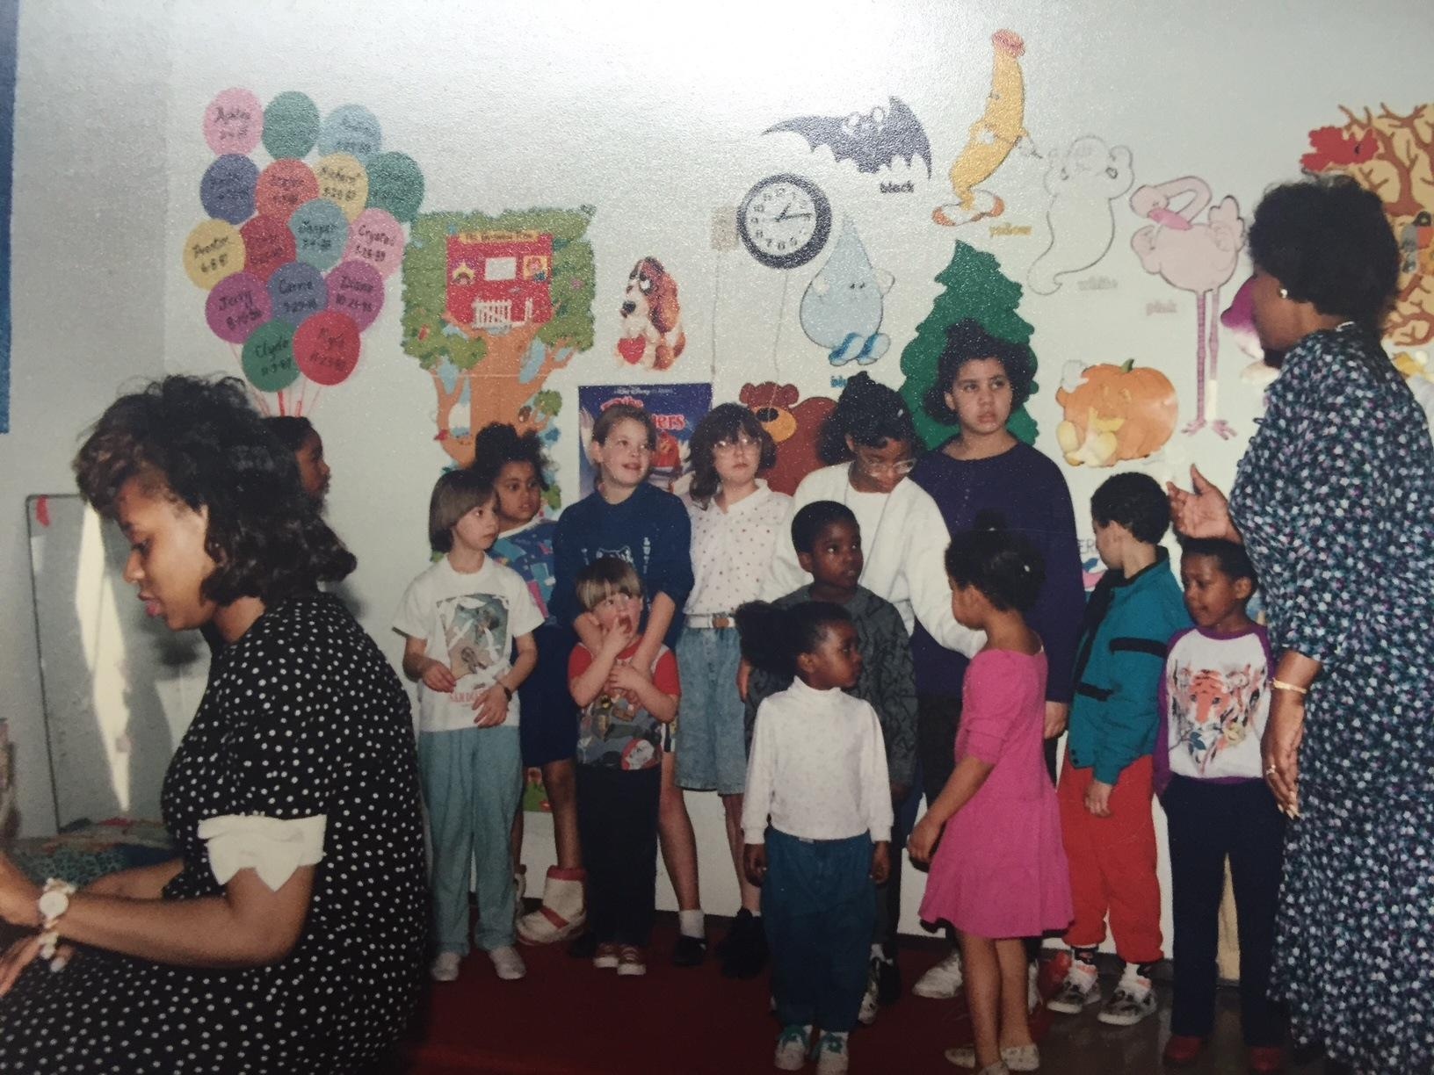
Hallelujah Children’s Choir
Kimberly Robinson (Green), accompanist

Slide 35
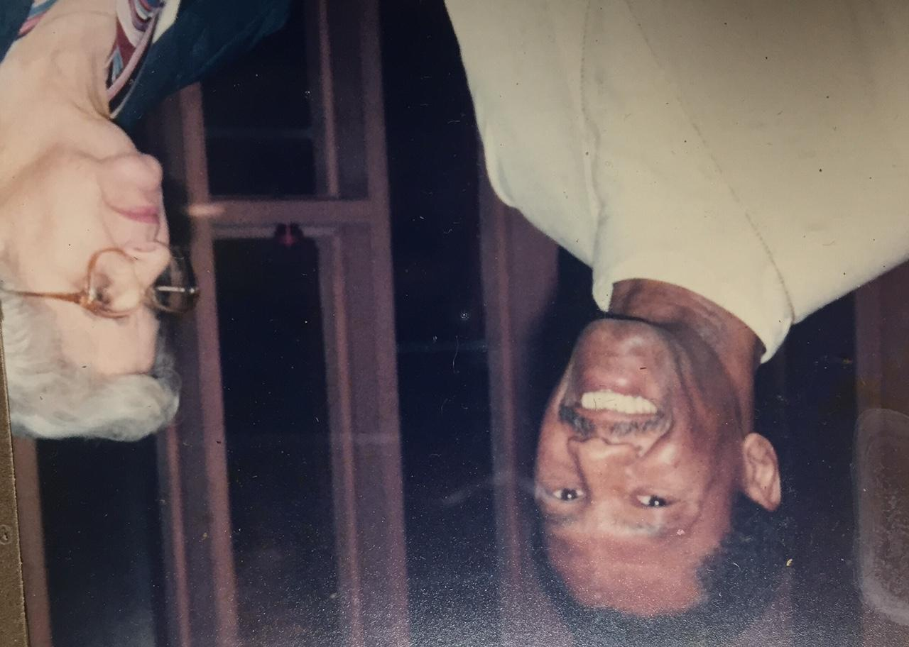
Kelly Chatman & Joan Miller. Kelly’s wife, Sheryl, directed the Hallelujah Kids Gospel Choir, founded in 1988-89.

Slide 36
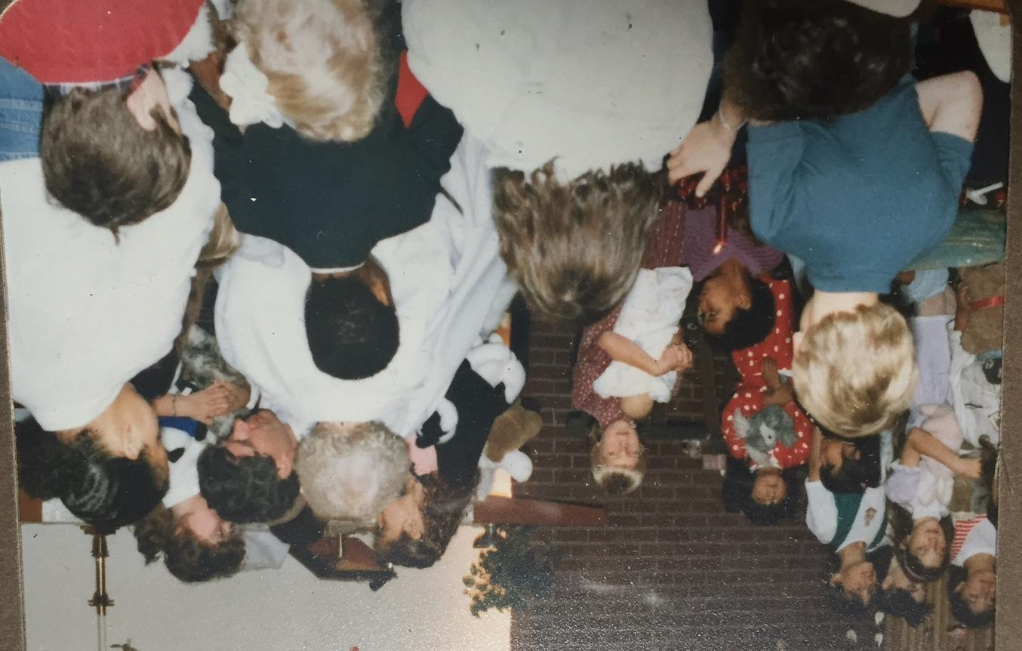
Blessing of the stuffed animals

Slide 37
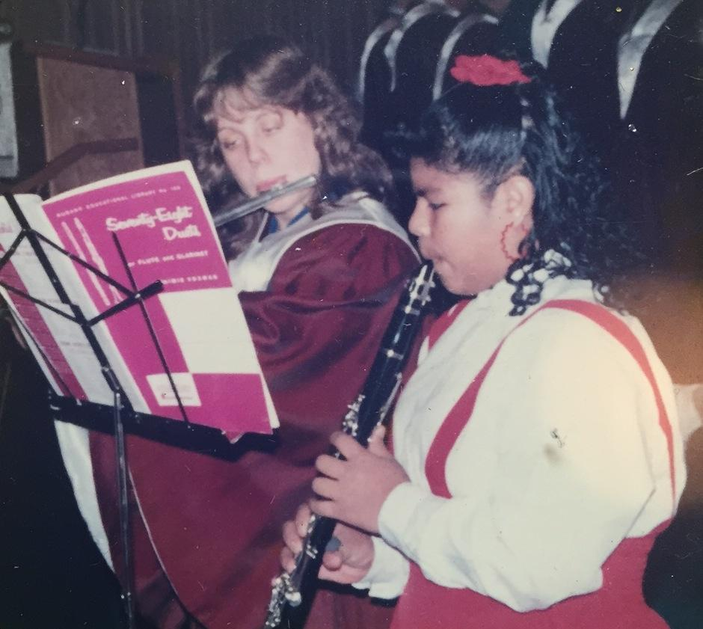
Lois Jordahl and Erika Pehrus

Slide 38
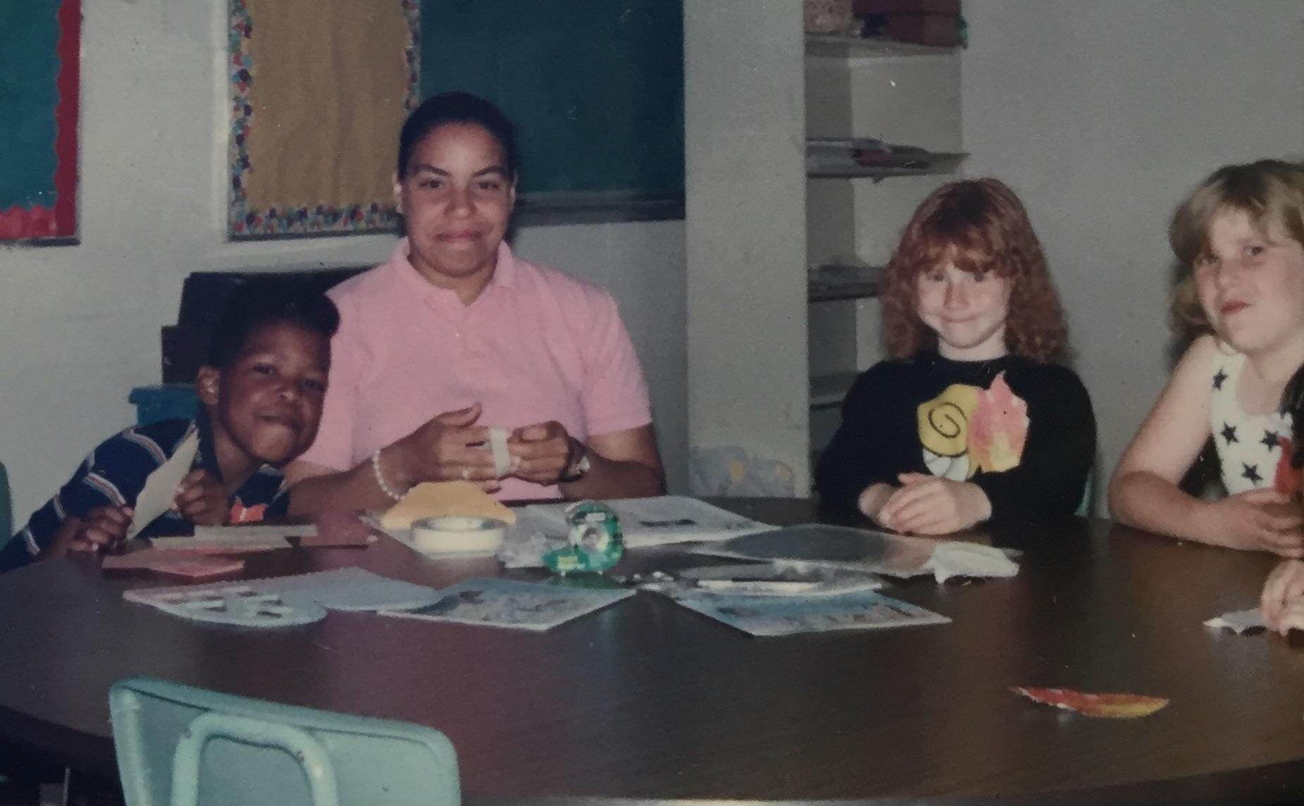
uRhonda Payne and her class

Slide 39
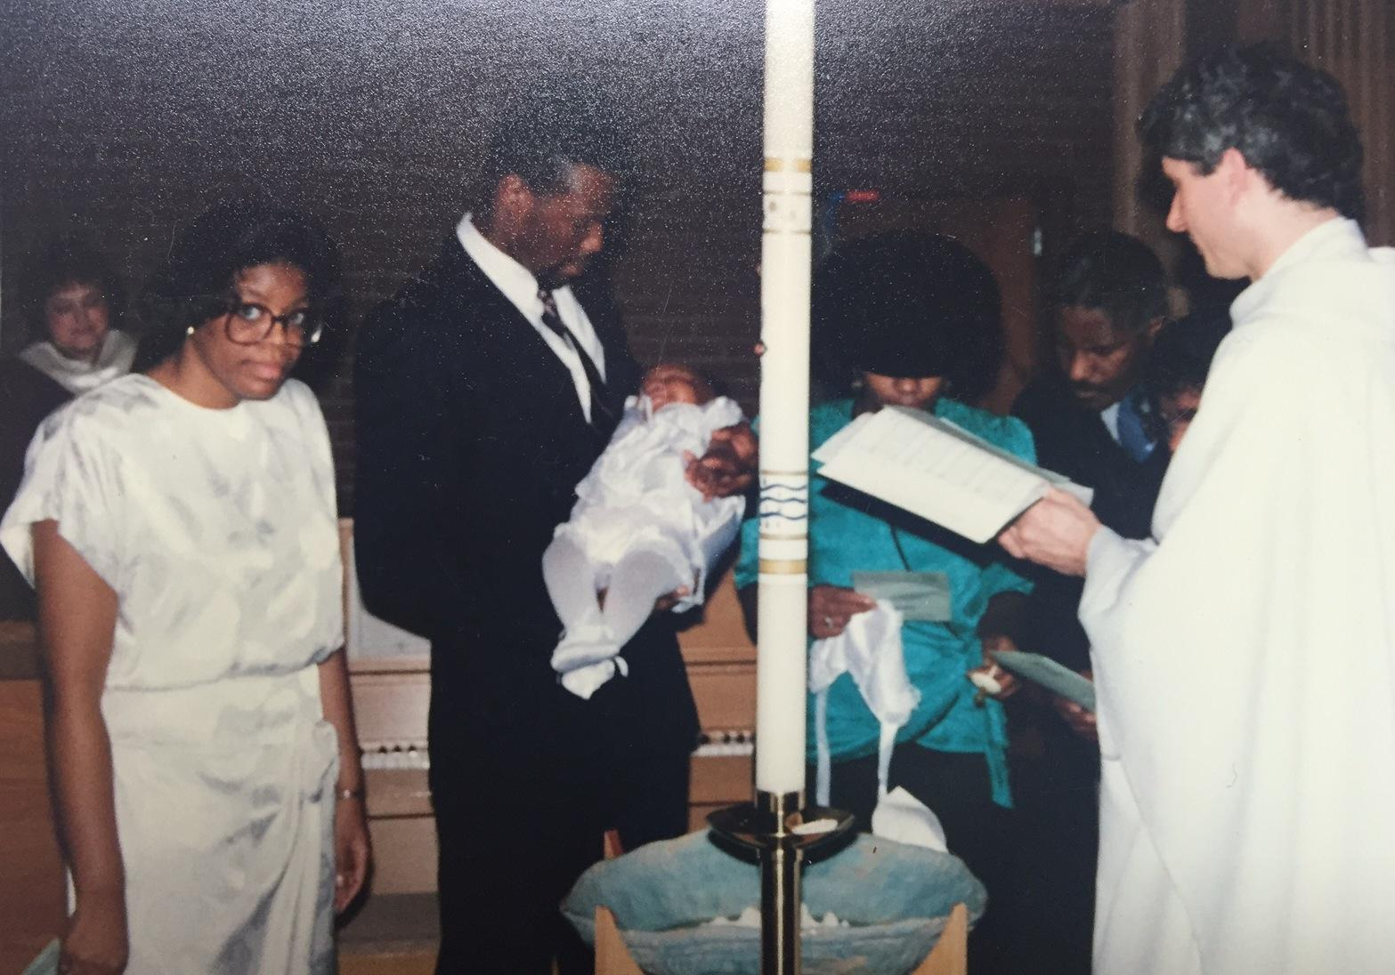
Baptism

Slide 40
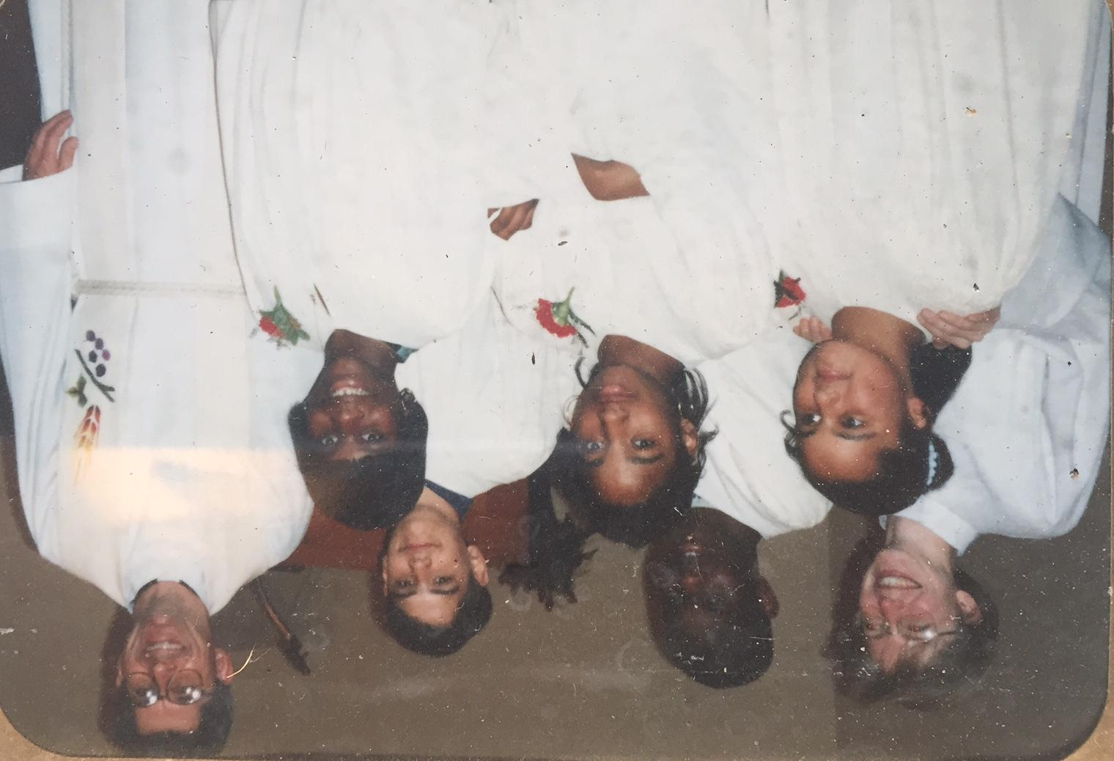
Confirmation Class: 1995
Solveig Nielsen-Goodin, intern
Danita Flint, RaShawn Barber-Hayes, Aisha Beasley, Devon Peters, Shawnta Barber, Pastor Moe

Slide 41
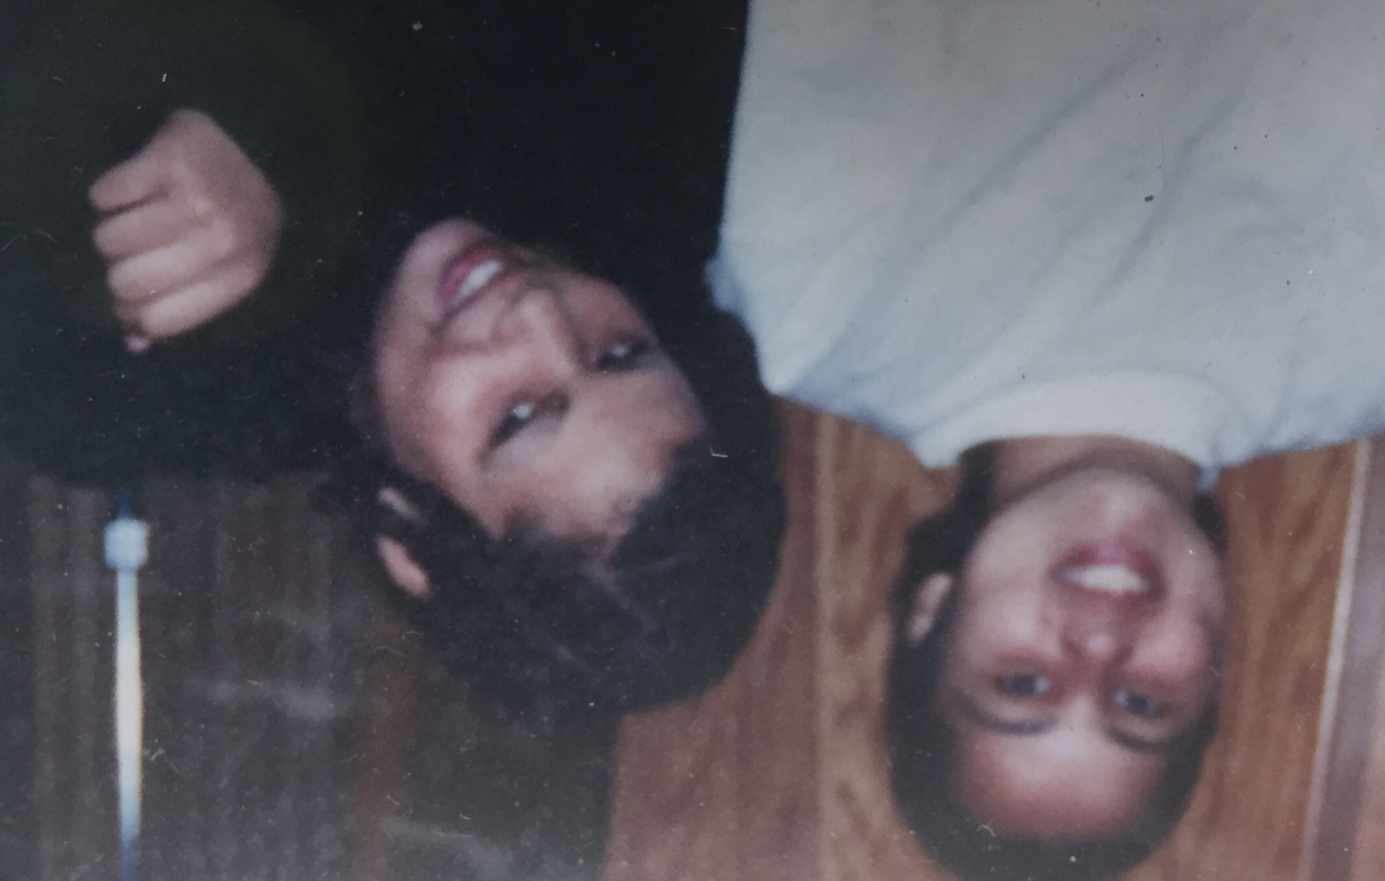
Danita and Ivy Flint

Slide 42
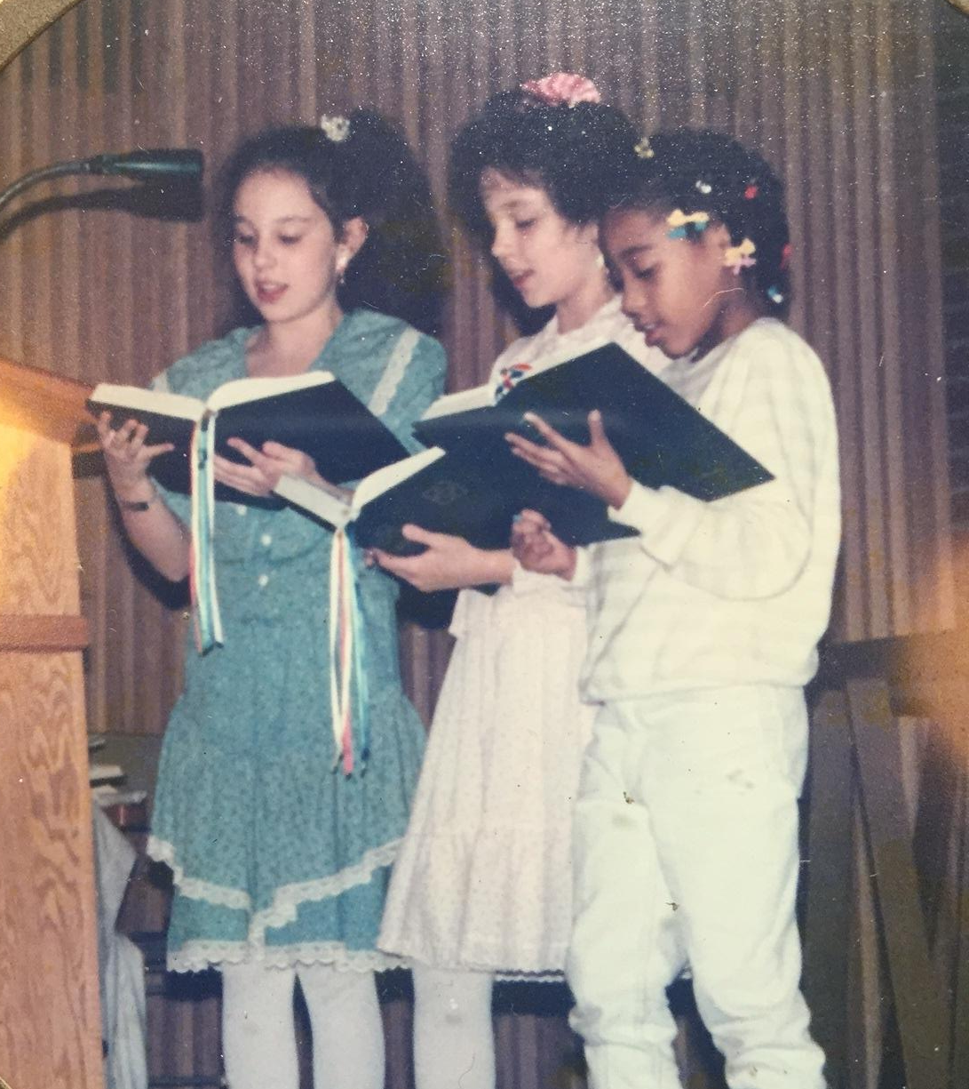
Driggs Twins and Friend sings a Christmas song. Helen Drigss, grandmother was a Redeemer member. Children participated through VBS

Slide 43
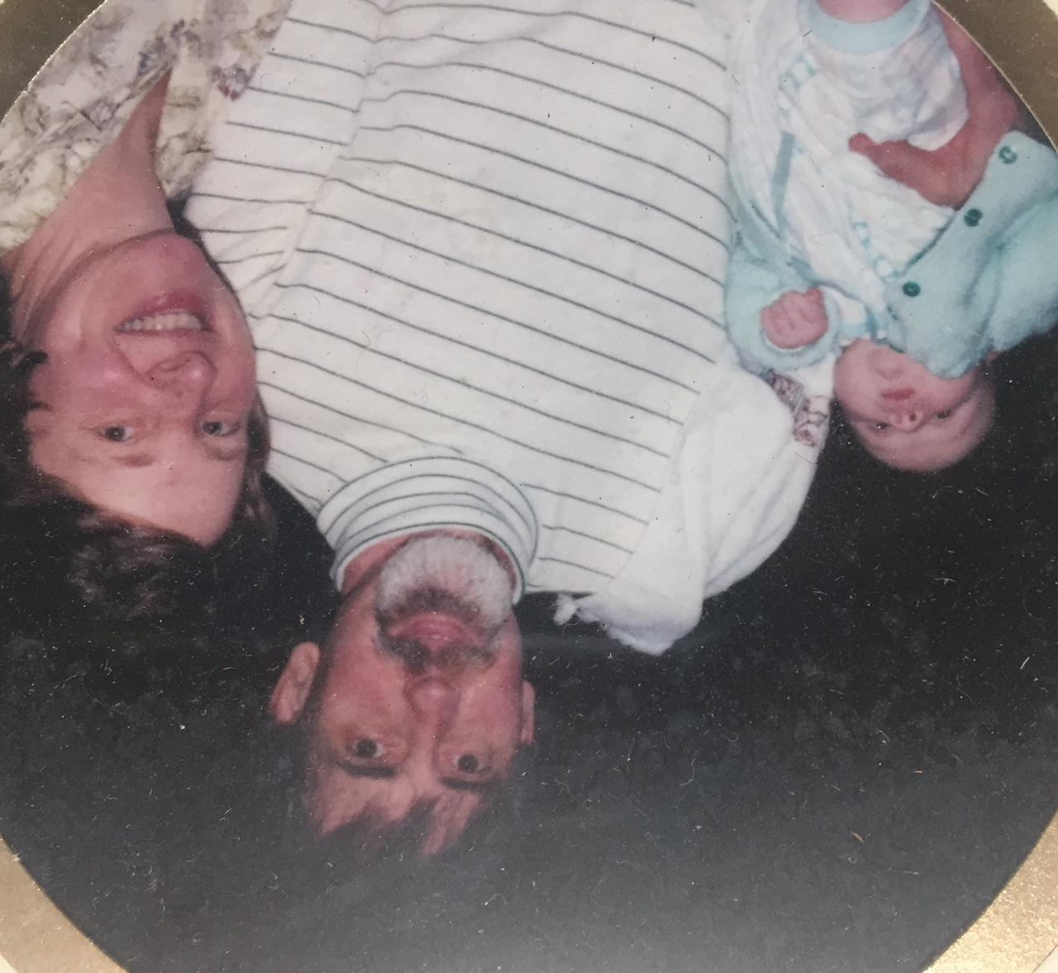
Paul and Lois Fox with baby Nat.

Slide 44
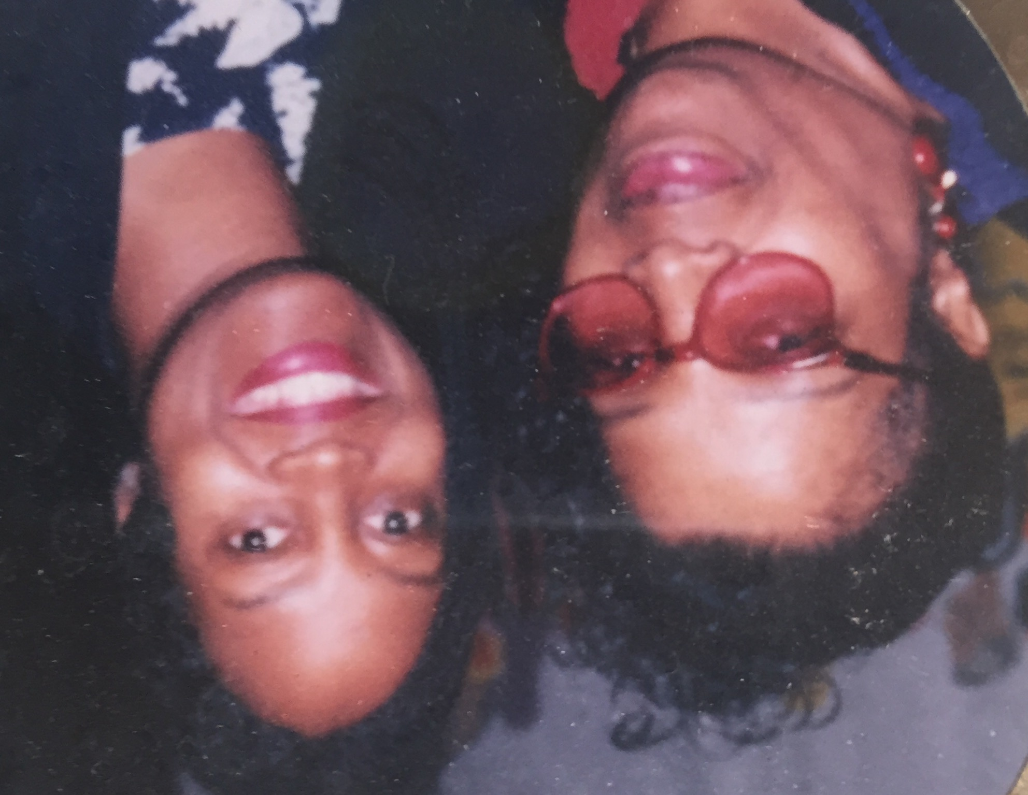
Martha Kirby & Carolyn Barnett (pianist)

Slide 45
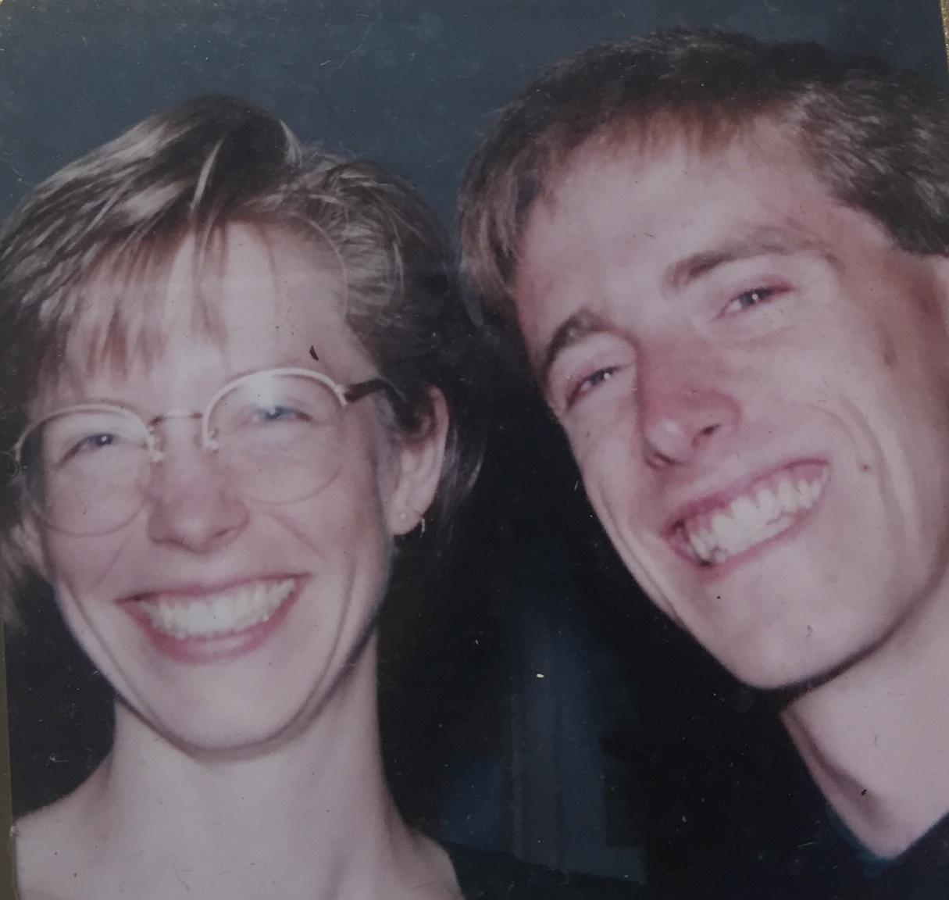
Solveign and Peter Nielsen: 1995

Slide 46
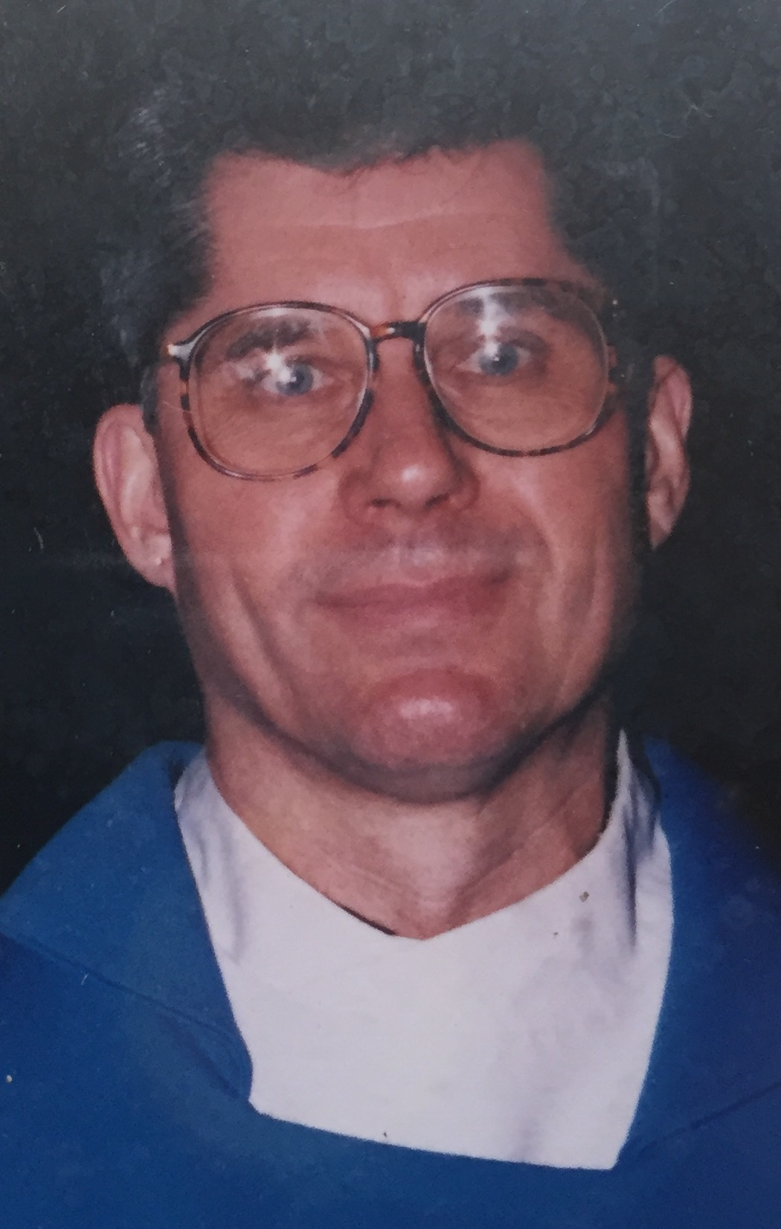
Terry Moe: 90’s

Slide 47
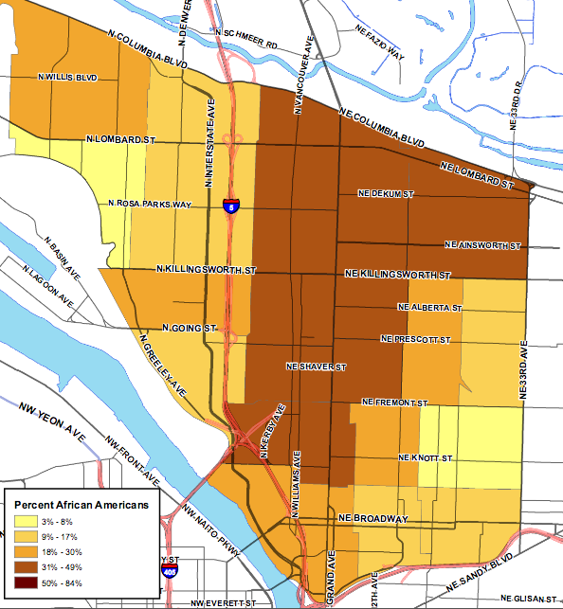
*
2000

Slide 48
1970
1990
1980
2000

Slide 49
Property
2005 Redeemer develops plans to sell 6 lots of its property (about 20,000 sq ft) in order to fund significant outreach and “To do something good for the community,” presumably affordable housing. In 2006 Redeemer considered a full price offer ($660,000) from Home Ownership One Street at a Time (HOST) to build 18-20 units of 60-80% of Median housing. As Redeemer went through a required Conditional Use Permit process with the city, the 2007 housing crisis happened setting things back. The first properties (2 parcels) sold to a market rate developer in 2010 allowing Redeemer to go forward with significant outreach, eventually Leaven, but the affordable housing dream was lost.
early-mid 2000’s
Land and Buildings

Slide 51
Community: 2000
Women of Redeemer continue to raise funds and do projects for church and community programs.
Intercongregational Vacation Bible School ceases as neighborhood changes
“Hallelujah Kids” choir ceases.
2003 - 2010 Enterbeing emerges and 2004 moves to a space on Alberta street. A satellite ministry of Redeemer on Alberta street. Art Gallery, classroom space, Wednesday Gatherings.
By 2010 the cost of space on Alberta is too expensive. Enterbeing is closed.
Wednesday night gatherings are held at Redeemer.
Congregation is involved in community organizing with Metropolitan Alliance for the Common Good.
early - mid 2000’s

Slide 52
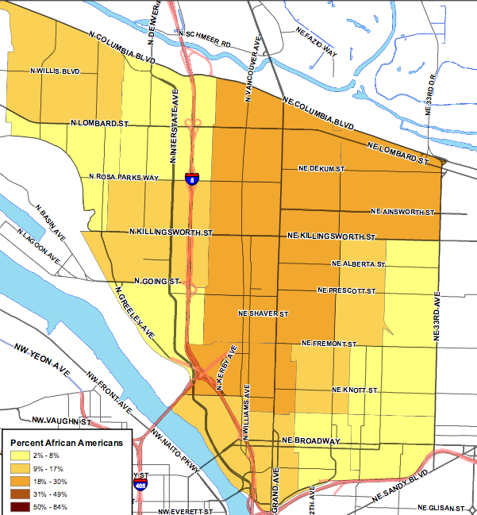
2010

Slide 53
1970
1990
2010
1980
2000

Slide 54
Property
Redeemer sells property on 19th and the house adjacent to the building on 20th Ave to help fund Leaven Project and eventually, Leaven Community/Salt & Light Lutheran.
The first properties (2 parcels) sold to a market rate developer in 2010 allowing Redeemer to go forward with significant outreach, eventually Leaven, but the affordable housing dream was lost.
2010 - present
Land and Buildings

Slide 55
Community: 2010
The Women of Redeemer group grows smaller as the women age. A core group continue to have a drive for school supplies. By 2015, the group ceases to meet.
2010: Leaven Project is formed. Melissa Reed is hired as the mission development pastor-organizer and Wendy Hall (Curtis) is hired as the community organizer. The community spends the next 3 years discerning what and how they will be in the changing neighborhood.
2013: The congregation of Redeemer Lutheran has it closing service. Salt and Light Lutheran has its opening service. Leaven Community is founded.
2014: Leaven Community receives it 501(c)3 non-profit status. Wendy Hall steps down from her position and LaVeta Gilmore Jones is hired as a community organizer-co director with Melissa.
2020: Melissa accepts position as a Bishops Associate in the ELCA Oregon synod. She continues her organizing work with the Leaven Land and Housing Coalition. LaVeta continues as co-director/organizer with the community.
2010 - present

